Slide 1


Slide 2
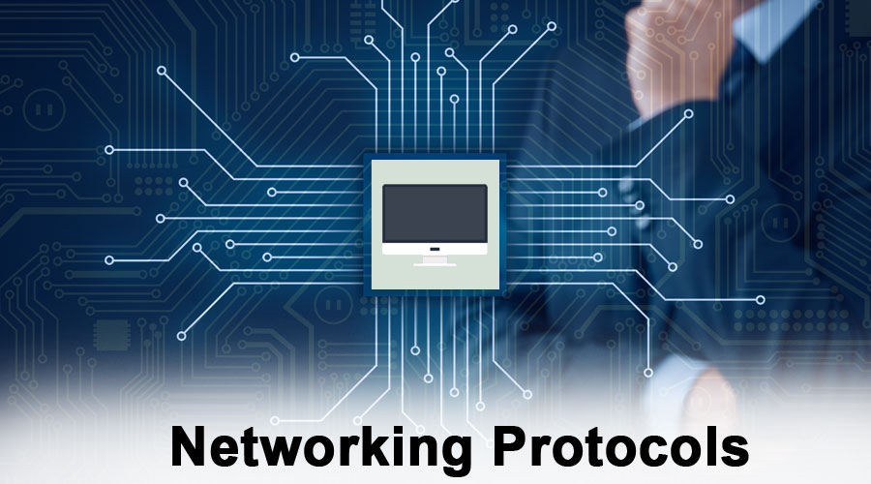

Slide 3

What Is a Network Protocol?
Network Protocols are a set of rules governing exchange of information in an easy, reliable and secure way.Network protocols are the reason you can easily communicate with people all over the world, and thus play a critical role in modern digital communications.Neither local area networks (LAN) nor wide area networks (WAN) could function the way they do today without the use of network protocols.Network protocols take large-scale processes and break them down into small, specific tasks or functions.Network protocols are typically created according to industry standard by various networking or information technology organizations. While network protocol models generally work in similar ways, each protocol is unique and operates in the specific way detailed by the organization that created it.

Slide 4
Types of Networking Protocol
There are various types of protocols that support a major and compassionate role in communicating with different devices across the network. These are:
HTTP(Hyper Text Transfer Protocol)
FTP(File Transfer Protocol)
PPP(Point-to-Point Protocol)
SMTP(Simple mail transport Protocol)
TCP/IP(Transmission Control Protocol/Internet Protocol)
POP3(Post office Protocol)
HTTPS(Hyper Text Transfer Protocol Secure)
TELNET
VoIP(Voice over Internet Protocol)

Slide 5
HTTP:
HTTP stands for HyperText Transfer Protocol.
It is a protocol used to access the data on the World Wide Web (www).
The HTTP protocol can be used to transfer the data in the form of plain text, hypertext, audio, video, and so on.
This protocol is known as HyperText Transfer Protocol because of its efficiency that allows us to use in a hypertext environment where there are rapid jumps from one document to another document.
HTTP is similar to the FTP as it also transfers the files from one host to another host. But, HTTP is simpler than FTP as HTTP uses only one connection, i.e., no control connection to transfer the files.
HTTP is similar to SMTP as the data is transferred between client and server. The HTTP differs from the SMTP in the way the messages are sent from the client to the server and from server to the client. SMTP messages are stored and forwarded while HTTP messages are delivered immediately
Features of HTTP
Connectionless protocol: HTTP is a connectionless protocol.
Media independent: HTTP protocol is a media independent as data can be sent as long as both the client and server know how to handle the data content.
Stateless: HTTP is a stateless protocol as both the client and server know each other only during the current request.

Slide 6
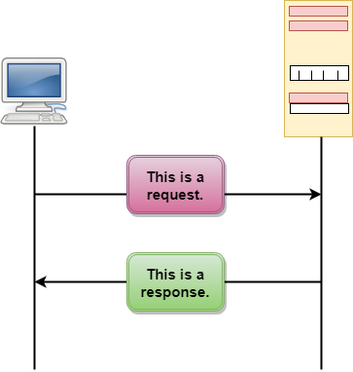
HTTP Transactions:
The above figure shows the HTTP transaction between client and server. The client initiates a transaction by sending a request message to the server. The server replies to the request message by sending a response message.
Request Message: The request message is sent by the client that consists of a request line, headers, and sometimes a body.
Response Message: The response message is sent by the server to the client that consists of a status line, headers, and sometimes a body.

Slide 7
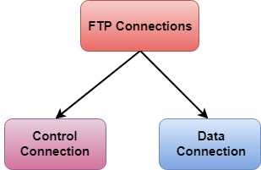
FTP:
FTP stands for File transfer protocol. FTP is a standard internet protocol provided by TCP/IP used for transmitting the files from one host to another. It is mainly used for transferring the web page files from their creator to the computer that acts as a server for other computers on the internet. It is also used for downloading the files to computer from other servers.
Advantages of FTP:
Speed: One of the biggest advantages of FTP is speed. The FTP is one of the fastest way to transfer the files from one computer to another computer.
Efficient: It is more efficient as we do not need to complete all the operations to get the entire file.
Security: To access the FTP server, we need to login with the username and password.
There are two types of connection in FTP:

Slide 8
PPP:
The PPP stands for Point-to-Point protocol. It is the most commonly used protocol for point-to-point access. Suppose the user wants to access the internet from the home, the PPP protocol will be used.It is mainly used for the communication between the two devices.It can be used over many types of physical networks such as serial cable, phone line, trunk line, cellular telephone, fiber
optic links such as SONET.
Services provided by PPP:
It defines the format of frames through which the transmission occurs.
It defines the link establishment process. If user establishes a link with a server, then "how this link establishes" is done by the PPP protocol.
It defines data exchange process, i.e., how data will be exchanged, the rate of the exchange.
Services Not provided by the PPP protocol:
t does not support flow control mechanism.
It has a very simple error control mechanism.
As PPP provides point-to-point communication, so it lacks addressing mechanism to handle frames in multipoint configuration.

Slide 9
SMTP:
SMTP stands for Simple Mail Transfer Protocol.
SMTP is a set of communication guidelines that allow software to transmit an electronic mail over the internet is called Simple Mail Transfer Protocol.
It is a program used for sending messages to other computer users based on e-mail addresses.
It provides a mail exchange between users on the same or different computers, and it also supports:
It can send a single message to one or more recipients.
Sending message can include text, voice, video or graphics.
It can also send the messages on networks outside the internet.
The main purpose of SMTP is used to set up communication rules between servers. The servers have a way of identifying themselves and announcing what kind of communication they are trying to perform. They also have a way of handling the errors such as incorrect email address. For example, if the recipient address is wrong, then receiving server reply with an error message of some kind.

Slide 10
TCP/IP:
The TCP/IP model was developed prior to the OSI model.
The TCP/IP model is not exactly similar to the OSI model.
The TCP/IP model consists of five layers: the application layer, transport layer, network layer, data link layer and physical layer.
The first four layers provide physical standards, network interface, internetworking, and transport functions that correspond to the first four layers of the OSI model and these four layers are represented in TCP/IP model by a single layer called the application layer.
TCP/IP is a hierarchical protocol made up of interactive modules, and each of them provides specific functionality.
Here, hierarchical means that each upper-layer protocol is supported by two or more lower-level protocols.

Slide 11
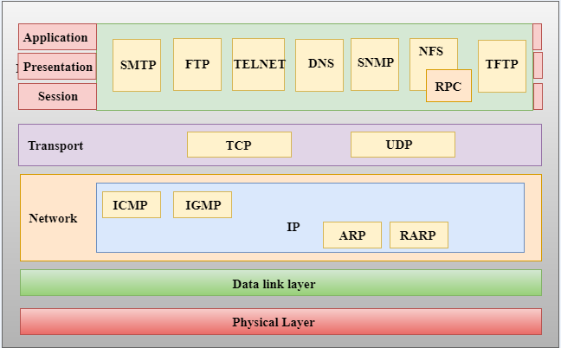
TCP/IP Layers:

Slide 12
POP3:
The POP protocol stands for Post Office Protocol. As we know that SMTP is used as a message transfer agent. When the message is sent, then SMPT is used to deliver the message from the client to the server and then to the recipient server. But the message is sent from the recipient server to the actual server with the help of the Message Access Agent. The Message Access Agent contains two types of protocols, i.e., POP3 and IMAP.

Slide 13
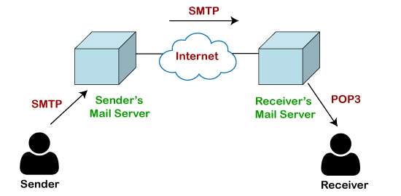
How is mail transmitted?

Slide 14
HTTPS:
HTTPS is an abbreviation of Hypertext Transfer Protocol Secure. It is a secure extension or version of HTTP. This protocol is mainly used for providing security to the data sent between a website and the web browser. It is widely used on the internet and used for secure communications. This protocol uses the 443 port number forcommunicating the data.This protocol is also called HTTP over SSL because the HTTPS communication protocols are encrypted using the SSL (Secure Socket Layer).By default, it is supported by various web browsers.Those websites which need login credentials should use the HTTPS protocol for sending the data.It allows users to create a secured encrypted connection and helps them to protect their information from being stolen.

Slide 15
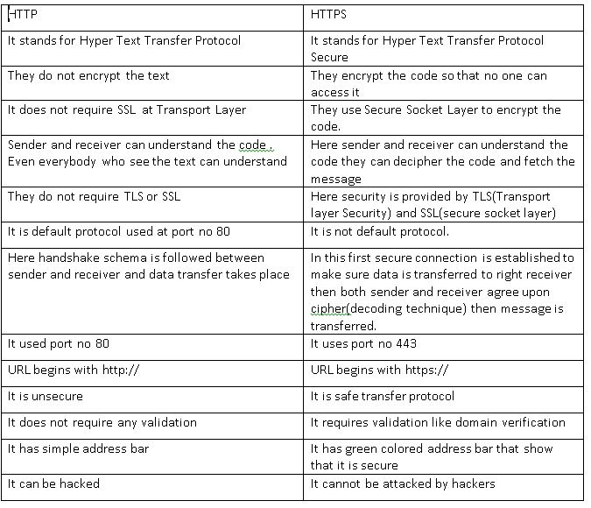

Slide 16
Advantages of HTTPS:
The main advantage of HTTPS is that it provides high security to users.
Data and information are protected. So, it ensures data protection.
SSL technology in HTTPS protects the data from third-party or hackers. And this technology builds trust for the users who are using it.
It helps users by performing banking transactions.
Disadvantages of HTTPS:
The big disadvantage of HTTPS is that users need to purchase the SSL certificate.
The speed of accessing the website is slow because there are various complexities in communication.
Users need to update all their internal links.

Slide 17
VoIP:
Voice over Internet Protocol (VoIP) is a technology that allows you to make voice calls using a broadband Internet connection rather than an analogue (traditional) phone line. Some VoIP services allow you to call multiple people at the same time, while others may allow you to call anyone. They can have or not have a phone number, which includes local, long-distance, mobile, and international numbers. Some VoIP services require you to use your computer or a special VoIP phone, whereas others allow you to use a regular phone connected to a VoIP adapter.

Slide 18
Disadvantage of VoIP:
Some VoIP services do not function during power outages, and the service provider may or may not provide backup power.
Not all VoIP services connect to emergency services directly via emergency service numbers.
VoIP service providers may or may not provide directory assistance.
Advantage of VoIP:
Some VoIP services provide features and services that are not available with a traditional phone or are only available for a fee.
It is possible to avoid paying for both a broadband connection and a traditional phone line.
A smoother connection than an analogue signal is possible.

Slide 19


